Slide 2
Overview
Our University’s Management Consultant curriculum (Role-based Cluster) is piloting the Business Case FVLJ in May 2015.
Apart from 3-4 weekly virtual touch-points, participants will need to take 5 eLearning modules between these virtual classroom sessions.
While the design of the of the virtual classrooms will be engaging and require maximum participation, the question of low completion rates of FVLJs still remain.
Keeping this challenge in mind, the OU team is proposing some interaction points between learners to motivate them to complete the learning journey successfully.

Slide 3
The objective of the pilot is to determine if these interaction points will increase completion rates through high learner engagement
The current pilot design is partly replicating the ‘Learning Week’ campaign on Talent.
A dedicated space on Talent will host:
5 eLearning modules (links to MyLearning)
A quiz (on Talent)
Links to Virtual Classrooms
Leaderboard
Details about the course etc.
Based on the quiz and participation level in virtual classrooms, participants will be awarded points and a rank. The portal will also display a Leaderboard to gamify the learning experience.
This is intended to let learners have a healthy competition amongst each other – to get to the end successfully.

Slide 4
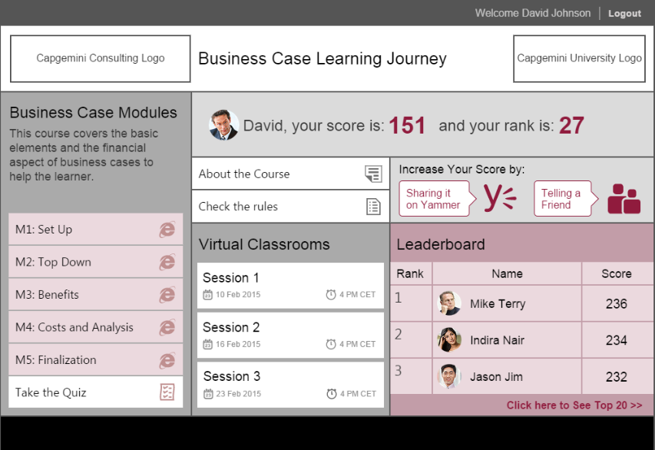
This mock-up defines how we envisioned the solution – Home Page

Slide 5
Cost of Pilot and Subsequent Runs
Course Details | Set-up – One time | Rise Platform Fees | Premium support & use of platform training | Total
Pilot | £2,100 (Rise fixed one-off) | 10p per metric per participant per month or part-month, based on minimum 100 users Pilot based on 10 metrics, and 2 months = £200 ProProfs = £100 | £ 1,200 (for total duration of pilot) – Rise | £3,500
Subsequent Runs # 1 | £5800 (Stepnet) | £0.10 x # participants x # metrics - assume 200 users (£400 for 2 months) | Premium support from Rise - £500 | £6700
Subsequent Runs | £0 | £0.10 x # participants x # metrics - assume 200 users (£400 for 2 months) | Premium support from Rise - £500 | £900

Slide 6
Team Structure and High Level Project Plan

